Slide 1
FCIA Gen 6 PlugFest
UNH-IOl GTP the week of June 20, 2016.
6/20 - 6/24
Test Tracks
V0.0 Draft

Slide 2
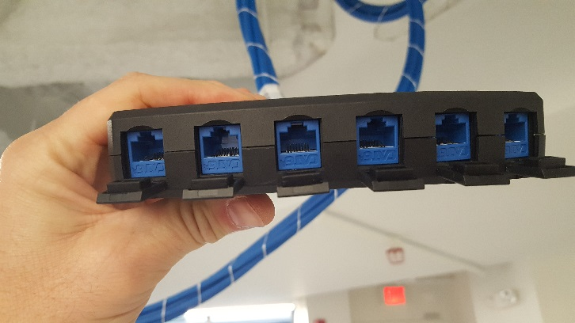
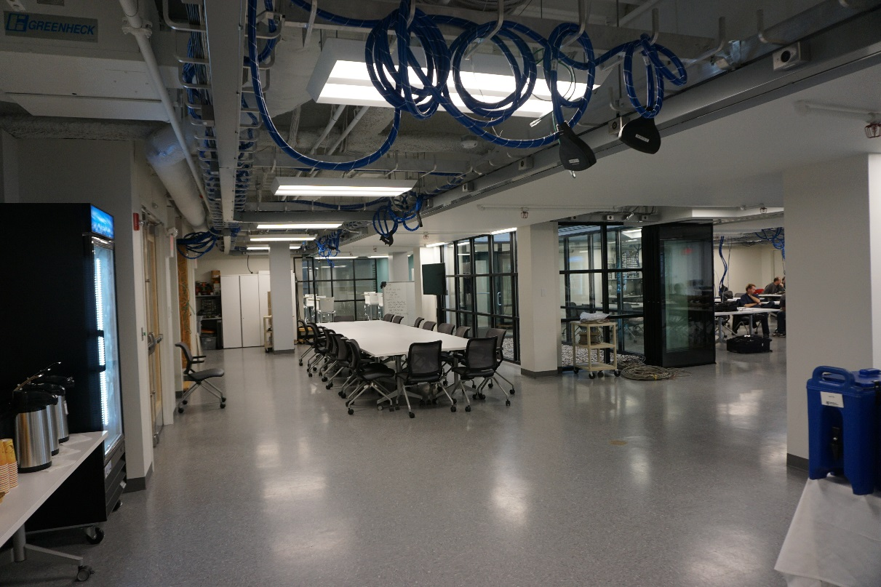
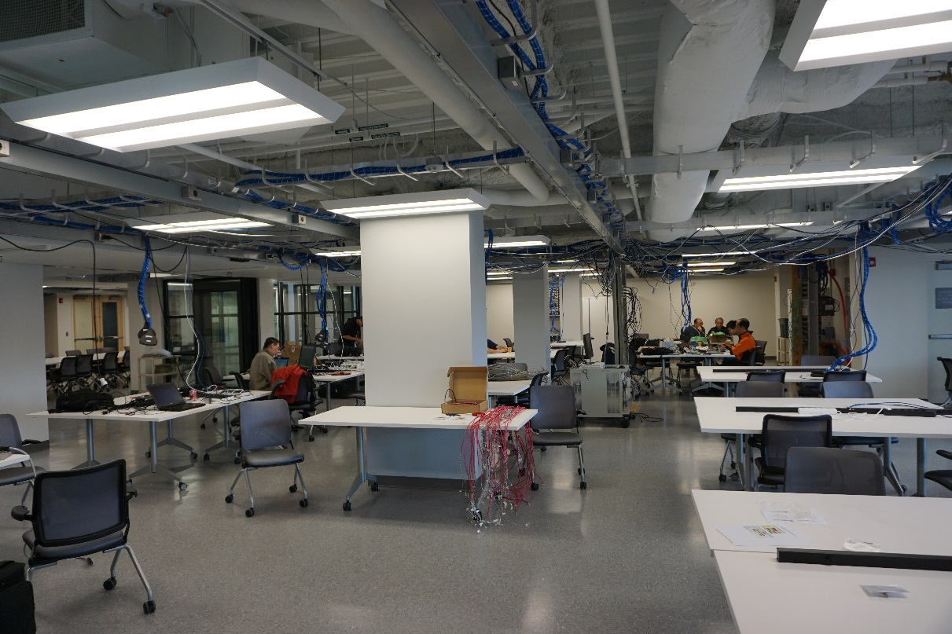
UNH-IOL GTP Facility
Please note our new UNH-IOL address
21 Madbury Rd., Ste 100
Durham, NH 03824
(downtown)
No fiber cables

Slide 3
FCIA GEN 6 Interoperability Test Plan
All participating devices shall conform to the recently published version of FC-BB-6 Standard version 2.00 published December, 2013. Initiators shall be configured with one of thefollowing applications to allow generation of LAN traffic at the same time as FCoE traffic:
a. NTCP (windows only)
b. iperf (linux only)
c. netperf (windows/linux)
d. Medusa MLTT tools (windows/linux)
Note: Medusa Lab's tool can be installed when you arrive at the event. For the ETS testing in the largefabric build, an external traffic source will be provided at the event. All participating hosts that arerunning Windows OS need to come with MPIO failover software installed.
FCoE – VLAN ID: 102, Priority 3, Lossless
Tagged UDP LAN traffic will be on VLAN ID 10, Priority 5, Lossless
Untagged LAN traffic will be on VLAN ID 1, Lossy

Slide 4
FCIA GEN 6 Interoperability Test Plan
Definitions:
FCoE switch: a Virtual bridged Local Area Network (VLAN) switch that contains a DCBswitch and a FCF and optionally a Fibre Channel interface.
DCB switch: a Virtual bridged Local Area Network (VLAN) switch that supports DCB functionalities but does not contain FCF functionality. A DCB switch may be either a Prestandard DCBX (CEE) switch or an IEEE standard DCBX (IEEE) switch.
FCF (FCoE Forwarder): A Fibre Channel Switching Element that is able to forward FCoE frames across one or more FCF-MACs and provides Fibre Channel Fabric services.
Converged Network Adapter (CNA): a Virtual bridged Local Area Network host adapter that is capable of driving TCP and/or iSCSI-over-DCB, and/or FCoE and/or iWARP traffic applications
FCoE Gateway: a component that is able to forward FCoE frames from an Ethernet MAC to a Fibre Channel interface, and that optionally includes one or more Lossless Ethernet bridging elements, but that does not include a Fibre Channel Switching Element or Fibre Channel Fabricservices.
FCoE Target: a Target that is accessed through an FCoE port.
FC Target: a Target that is accessed through an FC port.

Slide 5
FCIA GEN 6 Interoperability Test Plan
An FCoE switch for this Plugfest shall operate as a Standard IEEE DCBX switch CEE DCBX version 1.01 must also be supported
A DCB switch for this Plugfest shall operate as a Standard IEEE DCBX switch
Regarding Trace Capture During The Event:
1) Regarding the various traces taken during the test tracks throughout the Plugfest week, test equipment vendors will share them with the vendors that request them on the UNH ftp share, or direct via thumb drive. Internally, test equipment vendors may use some of the traces to correct/enhance their applications. At no time will any of the traces be shared/used outside of the test equipment vendors company, nor will they be used in any training courses.
2) If at any time a vendor would like a trace taken, but prefer to keep it private, the test equipment vendor will provide the trace to the vendor on a thumb drive, and then delete the original trace. Any vendor should feel free to ask anyone from the test equipment vendor capturing traces to accommodate.
3) If at any time a vendor would like to be certain that the test equipment vendor is not taking a trace on a given set of ports, they can contact UNH to disconnect the tap for that particular test (or verify that notap is connected).
4) Under no circumstances will a test equipment vendor connect a tap to snoop what traffic may be occurring on a link.

Slide 6
Test Track - Physical
32/16/8 G FC
FC Storage
Test Equipment
Server/HBA
32/16/8 G FC
Ethernet
FCoE
Native FC
Notes:
This is specially designed for customer with multi-storage vendor policy.

Slide 7
Test Track - Physical - proposals
Transmit : Transceiver
Optical : eyemask. Calibration of test signal could take ~6hrs worst case)
Then it would be ~10-15minutes per DUT
Amplitude - eye diagram. ~10minutes per transceiver. It uses the same signal, but different pattern(PRBs)
Jitter - eye diagram. ~10Min per transceiver. Same signal, different pattern
AOC test needed for 32G copper support: Electrical: same tests, same time
Equipment needed : Wave form Analyzer, Clock recovery unit, pattern generator, optical demux,
Electrical would require pattern generator
Receiver: Tranceiver
Electrical : Module electrical output (Optical in-Electrical out ) same ~6hr calibration, 15minutes per DUT
equipment : pattern generator with jitter capabilities and equalization settings
Host/NIC
Transmitter eye diagram and jitter need access to pattern generation on host/NIC for transmitter testing. 15minutes per DUT
BER needs access to loopback on NIC/host and would require ~6hr calibration, 15minutes per DUT
Equipment needed : pattern generator

Slide 8
Test Track 1 32/16/8G FC Interoperability Procedure
Procedure:
1. Connect the devices as shown in the test setup.
Generate patterns
Measure transmitter power
Observable Results:
● Verify eye patterns
● Possible Problems: None.

Slide 9
Test Track 1 32/16/8G FC Interoperability
32/16/8 G FC
32/16/8 G FC
FC Storage FC Storage
Request that transceiver lockout be disabled (if possible).
Test a matrix of multi-vendor 32/16/8G FC transceivers.
Test OM2,OM3, OM4 LC-LC
Test FC 32/16/8 G FC AOCs
32/16/8 G FC
congestion
load
Server/HBAs
Server/HBA
32/16/8 G FC
32/16/8 G FC
Ethernet
FCoE
Native FC
Notes:
This is specially designed for customer with multi-storage vendor policy.

Slide 10
Test Track 1 32/16/8G FC Interoperability Procedure
Procedure:
1. Connect the devices as shown in the test setup.
2. Verify that the Initiator and Targets shows up in the name server of the Switch.
3. Verify that the Initiator sees the Targets and can perform I/Os to them.
4. Perform 100% Write operations for 5 minutes to every Target.
5. Perform 100% Read operations for 5 minutes to every Target.
6. Perform 50% Read/ 50% Write operations for 5 minutes to every Target.
Use different physical cables and 32/16/8G speeds, and repeat step 1 through 6 until all options used.
Observable Results:
● Verify that all Initiators and Targets show up in the name server of the Switch.
● Verify that the Target and all of its drives show up in the management of the host initiator system
● Verify that the 5 minutes of Read and Write operations completes successfully between the Initiator and the Target. The 5 minutes of data may be any pattern: random, constant or a looped pattern.
Possible Problems: None.

Slide 11
Test Track 1 32/16/8G FC Interoperability Procedure
Extended Procedure:
FC AOC TBD lengths; OM2, OM3, OM4 media at 100m, 300, and 10km (if optics available)
Relative performance ratios of 2s from 8 to 16 to 32G for 100% read and 100% write.
Error rates - portshow and switch show to validate error free operation
No CRC or parity validation in switch and initiator and target.
Either trigger on ABTS or LR.
BBcredit R-RDY check - analyze. Frames and R_RDY counters and time.
Use in line traces to look at these events.
Oversubscribbed tests on both sides.
Dual switch test - load generator (not at 32G). Use several additional target and initiators to generate load.
Credit recover mechanism - random R-RDY drop and then more severe R_RDY so that recover reset occurs. Trace based validation of the recovery protocol.
Ask participants to verify they implement BBcredit recover?
Survey - of participants on who implement port security. Use reject as validation that security is working.
Port log dumps can be used to validate flogi/plogi/fdisc.
NPIV test - after port login test to validate NPIV features.
perturbations - cable pull short and long / port shut/undo shut.

Slide 12
Test Track 2 32/16/8G FC Multi-hop
32/16/8 G FC
32/16/8 G FC
FC Storage FC Storage
FCF
32/16/8 G FC
FCF
32/16/8 G FC
congestion
load
Server/HBAs
Server/HBA
32/16/8 G FC
32/16/8 G FC
Ethernet
FCoE
Native FC
Notes:
This is specially designed for customer with multi-storage vendor policy.

Slide 13
Test Track 2 32/16/8G FC Multi-hop Procedure
Procedure:
1. Connect the devices as shown in the test setup.
2. Verify that the Initiator and Targets shows up in the name server of the Switch.
3. Verify that the Initiator sees the Targets and can perform I/Os to them.
4. Perform 100% Write operations for 5 minutes to every Target.
5. Perform 100% Read operations for 5 minutes to every Target.
6. Perform 50% Read/ 50% Write operations for 5 minutes to every Target.
Use different physical cables and 32/16/8G speeds, and repeat step 1 through 6 until all options used.
Observable Results:
● Verify that all Initiators and Targets show up in the name server of the Switch.
● Verify that the Target and all of its drives show up in the management of the host initiator system
● Verify that the 5 minutes of Read and Write operations completes successfully between the Initiator and the Target. The 5 minutes of data may be any pattern: random, constant or a looped pattern.
Possible Problems: None.

Slide 14
Test Track 3 32/16/8G FC Direct Connect
32/16/8 G FC
FC Storage
Server/HBA
32/16/8 G FC
Ethernet
FCoE
Native FC
Notes:
This is specially designed for customer with multi-storage vendor policy.

Slide 15
Test Track 3 32/16/8G FC Direct Procedure
Procedure:
1. Connect the devices as shown in the test setup.
2. Verify that the Initiator sees the Targets and can perform I/Os to them.
3. Perform 100% Write operations for 5 minutes to every Target.
4. Perform 100% Read operations for 5 minutes to every Target.
5. Perform 50% Read/ 50% Write operations for 5 minutes to every Target.
6. Use different physical cables and repeat step 1 through 5 until all cable options have been used.
Observable Results:
● Verify that the Target and all of its drives show up in the management of the host initiator system
● Verify that the 5 minutes of Read and Write operations completes successfully between the Initiator and the Target. The 5 minutes of data may be any pattern: random, constant or a looped pattern.
Possible Problems: None.

Slide 16
Test Track 4 32/16/8G FC Multi-Vendor switch(NPV) Interoperability
32/16/8 G FC
32/16/8 G FC
FC Storage FC Storage
FCF Vendor A
32/16/8 G FC
NPV Vendor B
32/16/8 G FC
congestion
load
Server/HBA
Server/HBA
32/16/8 G FC
32/16/8 G FC
Ethernet
FCoE
Native FC
Notes:
This is specially designed for customer with multi-storage vendor policy.

Slide 17
Test Track 4 32/16/8G FC Multi-Vendor switch (NPV) Interoperability Procedure
Procedure:
1. Connect the devices as shown in the test setup.
2. Verify that the Initiator and Targets shows up in the name server of the Switch.
3. Verify that the Initiator sees the Targets and can perform I/Os to them.
4. Perform 100% Write operations for 5 minutes to every Target.
5. Perform 100% Read operations for 5 minutes to every Target.
6. Perform 50% Read/ 50% Write operations for 5 minutes to every Target.
Use different physical cables and 32/16/8G speeds, and repeat step 1 through 6 until all options used.
Observable Results:
● Verify that all Initiators and Targets show up in the name server of the Switch.
● Verify that the Target and all of its drives show up in the management of the host initiator system
● Verify that the 5 minutes of Read and Write operations completes successfully between the Initiator and the Target. The 5 minutes of data may be any pattern: random, constant or a looped pattern.
Possible Problems: None.

Slide 18
Test Track 5 32/16/8G FC Redundant Fabric/Availability
32/16/8 G FC
32/16/8 G FC
FC Storage FC Storage
congestion
load
32/16/8 G FC
32/16/8 G FC
Server1/HBA
32/16/8 G FC
Server1/HBA
Server2/HBA
32/16/8 G FC
32/16/8 G FC
Ethernet
FCoE
Native FC
Notes:
This is specially designed for customer with multi-storage vendor policy.

Slide 19
Test Track 5 32/16/8G FC Redundant Procedure
Procedure:
1. Connect the devices as shown in the test setup.
2. Verify that the Initiator and Targets shows up in the name server of the Switch.
3. Verify that the Initiator sees the Targets and can perform I/Os to them.
4. Perform 100% Write operations for 5 minutes to every Target.
5. Perform 100% Read operations for 5 minutes to every Target.
6. Perform 50% Read/ 50% Write operations for 5 minutes to every Target.
Use different physical cables and 32/16/8G speeds, and repeat step 1 through 6 until all options used.
Observable Results:
● Verify that all Initiators and Targets show up in the name server of the Switch.
● Verify that the Target and all of its drives show up in the management of the host initiator system
● Verify that the 5 minutes of Read and Write operations completes successfully between the Initiator and the Target. The 5 minutes of data may be any pattern: random, constant or a looped pattern.
Possible Problems: None.

Slide 20
Test Track 5 32/16/8G FC Redundant Procedure
Extended Procedure:
Use generic Linux and Windows MPIO.
Path selection - tests to verify policies on failover and failback.
Not custom MPIO drivers.
Test MPIO - connectivity test by failing a link.
Never loose a path to the target.
Physical paths remain in tack - but there are CRC or higher error rates - throughput degrades.
separate:
T10 - validation of end to end.

Slide 21
Test Track 6 25/10GbE FCoE
FCoE Storage
25/10GbE FCoE
congestion
load
Server/CNAs
Server/CNA
25/10GbE
25/10GbE
Ethernet
FCoE
Native FC
Notes:
This is specially designed for customer with multi-storage vendor policy.

Slide 22
Test Track 6 25/10GbE FCoE Procedure
Procedure:
1. Connect the devices as shown in the test setup.
2. Verify that the Initiator and Targets shows up in the name server of the Switch.
3. Verify that the Initiator sees the Targets and can perform I/Os to them.
4. Perform 100% Write operations for 5 minutes to every Target.
5. Perform 100% Read operations for 5 minutes to every Target.
6. Perform 50% Read/ 50% Write operations for 5 minutes to every Target.
Use different physical cables and 32/16/8G speeds, and repeat step 1 through 6 until all options used.
Observable Results:
● Verify that all Initiators and Targets show up in the name server of the Switch.
● Verify that the Target and all of its drives show up in the management of the host initiator system
● Verify that the 5 minutes of Read and Write operations completes successfully between the Initiator and the Target. The 5 minutes of data may be any pattern: random, constant or a looped pattern.
Possible Problems: None.

Slide 23
Test Track 7 Converged
32/16/8 G FC
FC Storage FCoE Storage
32/16/8 G FC
25/10GbE FCoE
congestion
load
32/16/8 G FC
25/10GbE FCoE
Server1/HBA
32/16/8 G FC
Server1/CNA
Server2/HBA
25/10GbE
32/16/8 G FC
Ethernet
FCoE
Native FC
Notes:
This is specially designed for customer with multi-storage vendor policy.

Slide 24
Test Track 7 Converged Procedure
Procedure:
1. Connect the devices as shown in the test setup.
2. Verify that the Initiator and Targets shows up in the name server of the Switch.
3. Verify that the Initiator sees the Targets and can perform I/Os to them.
4. Perform 100% Write operations for 5 minutes to every Target.
5. Perform 100% Read operations for 5 minutes to every Target.
6. Perform 50% Read/ 50% Write operations for 5 minutes to every Target.
Use different physical cables and 32/16/8G speeds, and repeat step 1 through 6 until all options used.
Observable Results:
● Verify that all Initiators and Targets show up in the name server of the Switch.
● Verify that the Target and all of its drives show up in the management of the host initiator system
● Verify that the 5 minutes of Read and Write operations completes successfully between the Initiator and the Target. The 5 minutes of data may be any pattern: random, constant or a looped pattern.
Possible Problems: None.

Slide 25
Test Track 8 Converged Multi-hop
32/16/8 G FC
FC Storage FCoE Storage
FCF
32/16/8 G FC
FCF
32/16/8 G FC
congestion
load
Server/HBA + CNA
Server1/CNA
Server2/HBA
32/16/8 G FC + 25/10gGbE CNA
25/10GbE
32/16/8 G FC
Ethernet
FCoE
Native FC
Notes:
This is specially designed for customer with multi-storage vendor policy.

Slide 26
Test Track 8 Converged Multi-hop Procedure
Procedure:
1. Connect the devices as shown in the test setup.
2. Verify that the Initiator and Targets shows up in the name server of the Switch.
3. Verify that the Initiator sees the Targets and can perform I/Os to them.
4. Perform 100% Write operations for 5 minutes to every Target.
5. Perform 100% Read operations for 5 minutes to every Target.
6. Perform 50% Read/ 50% Write operations for 5 minutes to every Target.
Use different physical cables and 32/16/8G speeds, and repeat step 1 through 6 until all options used.
Observable Results:
● Verify that all Initiators and Targets show up in the name server of the Switch.
● Verify that the Target and all of its drives show up in the management of the host initiator system
● Verify that the 5 minutes of Read and Write operations completes successfully between the Initiator and the Target. The 5 minutes of data may be any pattern: random, constant or a looped pattern.
Possible Problems: None.

Slide 27
Test Track 9 Converged Multi-Vendor switch (NPV) Interoperability
32/16/8 G FC
FC Storage FCoE Storage
FCF
NPV
congestion
load
Server/HBA + CNA
Server1/CNA
Server2/HBA
32/16/8 G FC + 25/10gGbE CNA
25/10GbE
32/16/8 G FC
Ethernet
FCoE
Native FC
Notes:
This is specially designed for customer with multi-storage vendor policy.

Slide 28
Test Track 9 Converged Multi-Vendor switch(NPV) Procedure
Procedure:
Connect the devices as shown in the test setup.
Verify that the Initiators and Targets shows up in the name server of the FCF.
Verify that all of the Initiators on the fabric see the Targets and can perform I/Os to them.
Perform 50% Read/ 50% Write operations simultaneously from every Initiator to every Target. During the I/Os disconnect then reconnect each cable plugged into the top HA FCoE Switches. Continue to perform I/Os throughout the cable pull process.
Repeat Step 4 for the bottom HA FCoE Switch.
Perform 50% Read/ 50% Write operations simultaneously from every Initiator to every Target. During the I/Os power cycle the top HA FCoE Switch. Continue to perform I/Os throughout the power cycle process.
Repeat Step 6 for the bottom HA FCoE Switch.
Observable Results:
Verify that all Initiators and Targets show up in the name server of the FCF.
Verify that the Target and all of its drives show up in the management of each host initiator system
Verify that the 5 minutes of Read and Write operations completes successfully between all Initiators and the Targets. The 5 minutes of data may be any pattern: random, constant or a looped pattern.
Verify that when the HA FCoE Switches are power cycled or when cables are disconnected/reconnected that traffic seamlessly fails over to the remaining switch and traffic is not disrupted when the switch leaves the network or returns.
Possible Problems: None.

Slide 29
End

