Slide 1
FCIA 64GFC PlugFest Oct.23 to Oct. 27 (8 to 5) plugfest@lists.fibrechannel.org
Host: FCIA at UNH-IOL GPT lab
NDA required for participation began on 9/20/2023
Plugfest general information page: https://fibrechannel.org/plugfest-general-info/
NDA: https://fibrechannel.org/wp-content/uploads/2023/08/NDA-Plugfest-2023-update.pdf
Plugfest Registration Page: https://fibrechannel.org/plugfest-registration-payment/

Slide 2
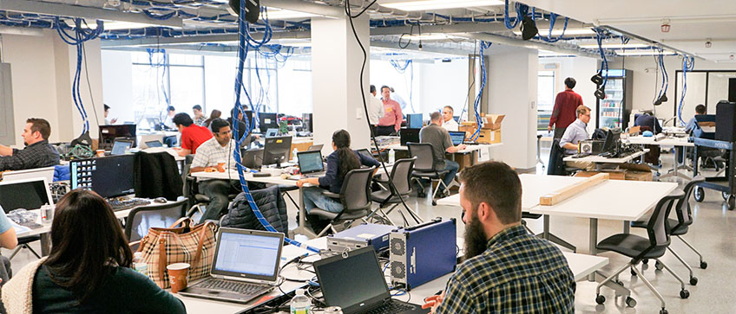
UNH-IOL Plugfest Facilities
UNH-IOL, 21 Madbury Road Durham, NH 03824 USA
4200 SqFt facility
Flexible power options
120v 20a 60hz AC
220v 20a 60hz (L6-20R)
WiFi Network
Shipping
Items can be shipped to – by 10/20 and then from facility 10/27 or 10/30
The blue cable drops depicted are 1G rj45 and can provide internet access for any server. Can ping to devices connected on these ethernet drops from a device connected to IOL wifi

Slide 3
No Photos
Please respect confidentiality of your colleagues.
All companies have agreed to UNH-IOL Usage Agreement
UNH-IOL may take some ‘generic’ photos.
If you would like a photo of your team, or your own equipment setup, please check with UNH-IOL staff first.

Slide 4
Travel
Visa Invitation Letter Contact:
Jkahn@iol.unh.edu
Shipping Address:
FCIA Plugfest ℅ James Kahn
21 Madbury Rd Suite 100
Durham, NH 03824
📞: 603-862-0090
Equipment must arrive by October 19th
Hotels, Travel, Parking Info:
https://www.iol.unh.edu/about/visit
Airports: ✈
MHT - Manchester Boston Regional Airport (🕐1 hr)
BOS - Boston Logan International Airport (🕒1hr 30mins)
Train: 🚄
Amtrak - Downeaster
Boston North Station > Durham-UNH
http://www.amtrakdowneaster.com/

Slide 5
Logistics
Plugfest runs Monday - Friday
Doors open at 8AM, testing until 5PM
Kickoff meeting Monday @ 11AM

Slide 6
Registration summary as of 10/16
Amphenol CS | Sam Kocsis | sam.kocisi@amphenol-tcs.com fan.fu@amphenol-tcs.com chris.lyon@amphenol-tcs.com Paul.Coddington@mphenol-highspeed.com | 64GFC Modules | 32GFC modules
Hewlett Packard Enterprise | Barry Maskas | barry.maskas@hpe.com matthew.j.goepfert@hpe.com | 3x HPE ProLiant DL360 Gen11 64GFC Adapters for UNH conformance | SN1700Q; SN1700E; 64GFC modules
Cisco Systems | Kiran Ranabhor | kranabho@cisco.com | Cisco MDS 64G 48 port Fibre Channel Fixed switch | Cisco MDS 64G 96 port Fibre Channel Fixed switch
Marvell Technology, Inc. | Ray Leung | rayleung@marvell.com | QLE2872 2p 64G HBA | QLE2772 2p 32GFC HBA
Adtran, Inc. | Andrew Adams | andrew.adams@adtran.com james.cannella@adtran.com althea.wilkinson@adtran.com | FSP 3000 S-Flex | FSP3000 Open Line System (OLS) 400G DWDM Muxponder Multiple (AM-S23L, OPPM-F, SH4)
SANBlaze | Rick Walsh | rwalsh@sanblaze.com djbanack@sanblaze.com SElwell@sanblaze.com | 2x SANBlaze target /initiator 64G FC emulator
Broadcom Inc | Mark Jones | mark.jones@broadcom.com | 2x servers Emulex LPe36002 64G HBA | 2x Brocade G720 64G switch
Teledyne Lecroy | Nick Kriczky | nick.kriczky@teledyne.com jim.yasueda@teledyne.com craig.foster@teledyne.com josh.harsch@teledyne.com | 2x SierraNet M648 | Analyzer-Jammer
Exfo Inc. | Anabel Alarcon | anabel.alarcon@exfo.com fabien.courchesne@exfo.com eric.carignan@exfo.com | FTB4-PRO with 2x FTBx-88260 | FTB1v2-PRO with 2x FTBx-88480 FC 32G BER Tester

Slide 7
PlugFest Participants mailto:plugfest@lists.fibrechannel.org
1. Adtran | Andy (3)– out Thursday and Friday. | Point to point link equipment - 16/32 with Cisco demonstrated – need to test 64GFC; Brocade – 64/32/16 demonstrated. | 1 shelf two blades – support MMF or SMF HOST connectivity and trunks and mixed speeds. Cisco and Brocade on different client ports at same time. | Provide longer latency | Supports a x7 lane trunk
2. Amphenol | Paul and Chris (2) | 64GFC Transceivers supported by Marvell and HPE-Q. | working on providing OM4 LC cables | Attempted support on Adapters
3. Broadcom | Mark (1) | 2 servers – I or T SPDK – share NVMe-oF target. Two Brocade G720 switches – check for extension and trunk license ? | FPIN LI in Linux – sent to host MPIO path management flap . Note: if device not registered for FPIN it is difficult to identify congestion cause | Switch and adapter Optic lock – will try to bring adapter unlocked FW | Oversubscription + long latency
4. Cisco | Kiran | 2 switches – trunking + E port all features are supported | Dozen optics, just a couple of LRs – 64/32G
5. EXFO | Eric (3) | Two 88480 two 88360 32G/64G interop with optics. | Link with point to point for fabric – training and login. Serves an end point to validate link level protocol and signal quality. BER analysis. | 32G/64G interop
6. HPE | Barry and Matt (2) Barry out Wednesday | Extra 64GFC Q and E HBAs for IOL server install. | 3 DL360 G11 servers - B and Q 64GFC HBAs; 1 32/16/8GFC HBA; Sanblaze FC 6x64GFC; 64GFC switch | OM4 cables mgmt laptop | 1G OOB mgmt switch (172.17.xx.xx subnet) + RJ45 Serial switch
7. Marvell | Ray (1) | Two servers – 3 OSs – RH, WS, Ubuntu – 64GFC HBA | 32GFC HBA for UNH server and other testing | HBA Optics lock not implemented
8. Sanblaze | Steve (2) | Capability to Send FPIN – but does not cause congestion | Two SANBlaze servers – 8 FC ports available I or T; 2 64GFC Marvell HBAs; 2 64G Broadcom HBAs | Any of 8 ports can be I or T; FC or FC-NVMe
9. Teledyne LeCroy | Jim/Craig/Josh (3) | 2 M648 – inline initially on B and C ISL | Jammer licensed to drop credits to idle | Change status on return path to cause an LI event
10. UNH | James and Tim | GPT bench layout - Switches and analyzers and Adtran blades in center, servers on edges | Two or 3 systems for 64/32GFC HBA installs for Ubuntu/Interact FC-NVMe conformance tests | 15 Medusa licenses available | Will install 64GFC HBAs – can setup as regular servers with 32G or 64G HBAs
 | Head count 18 to 20 | Shipping – arrive by Oct. 20. | Friday - Packing can be supported by the IOL | Food service – is good to go. | Holliday Inn Express is within walking distance

Slide 8
EXFO Test Track complete/not-complete
 | M |  | Tu |  | W |  | Th |  | F
Adtran-B
Adtran-C
Amphenol-xcvrs
Broadcom SW1 |  | Verify F-port to F-port
Broadcom SW2
Broadcom S1
Broadcom S2
Cisco SW1
Cisco Sw2 |  | Verify F-port to F-port
EXFO-1 | verify all 64GFC xcvrs |  | verify all 64GFC xcvrs |  | verify all 64GFC xcvrs
EXFO-2 |  | verify all 32GFC xcvrs |  | verify all 32GFC xcvrs |  | verify all 32GFC xcvrs
HPE S1
HPE S2
HPE S3
HPE SBZ-T1
HPE SBZ-T2
HPE SBZ-T3
Marvell S1
Marvell S2
Sanblaze SE1-T
Sanblaze SQ2-T
Sanblaze SE1-I
Sanblaze SQ2-I

Slide 9
IOL INTERACT Test Track complete/not-complete
 | M |  | Tu |  | W |  | Th |  | F
UNH-S1 | Broadcom HBA 64GFC | Broadcom HBA 64GFC | Broadcom HBA 32GFC | Broadcom HBA 32GFC
UNH-S2 | Marvell HBA 64GFC | Marvell HBA 64GFC | Marvell HBA 32GFC | Marvell HBA 32GFC
UNH-S3 |  | HPE E-HBA 64GFC | HPE Q-HBA 64GFC | HPE Q-HBA 32GFC | HPE E-HBA 32GFC
HPE 64GFC switch
HPE S1 (Ubuntu)
Broadcom S2 (SPDK Target)
SANBlaze (Target) Sanblaze SQ2-T
SANBlaze (Target) Sanblaze SE1-T

Slide 10
ADTRAN Test Track complete/not-complete
 | M |  | Tu |  | W |  | Th |  | F
Adtran-B |  | Path switching redundant link
Adtran-C |  | Path switching redundant link
Amphenol-xcvrs
Broadcom SW1
Broadcom SW2
Broadcom S1
Broadcom S2
Cisco SW1
Cisco Sw2
EXFO-1 |  |  | F-port test |  | F-port test
EXFO-2 |  |  | F-port test |  | F-port test
HPE S1
HPE S2
HPE S3
HPE SBZ-T1
HPE SBZ-T2
HPE SBZ-T3
Marvell S1
Marvell S2
Sanblaze SE1-T
Sanblaze SQ2-T
Sanblaze SE1-I
Sanblaze SQ2-I
TDLC-1 |  | Look for LR or FLOGI
TDLC-2 |  | Look for LR or FLOGI

Slide 11
Fabric Test Tracks complete/not-complete
 | M |  | Tu |  | W |  | Th |  | F
Adtran-B
Adtran-C
Amphenol-xcvrs |  |  | In use if operational
Broadcom SW1 |  |  | isl link | Trunk
Broadcom SW2 |  |  | isl link | trunk
Broadcom S1
Broadcom S2
Cisco SW1 |  |  | isl link | Trunk
Cisco Sw2 |  |  | isl link | Trunk
EXFO-1 |  |  | F-port to F-port test
EXFO-2
HPE S1
HPE S2
HPE S3
HPE SBZ-T1 |  |  | Intect FPIN | Intect FPIN
HPE SBZ-T2 |  |  | Inject FPIN | Inject FPIN
HPE SBZ-T3 |  |  | Inject FPIN | Inject FPIN
Marvell S1
Marvell S2
Sanblaze SE1-T
Sanblaze SQ2-T
Sanblaze SE1-I
Sanblaze SQ2-I
TDLC-1 |  |  | disable BBcredit recovery and jam r_rdy | Replace R_RDY with FPIN or FPIN LI
TDLC-2 |  |  | disable BBcredit recovery and jam r_rdy | Replace R_RDY with FPIN or FPIN LI

Slide 12
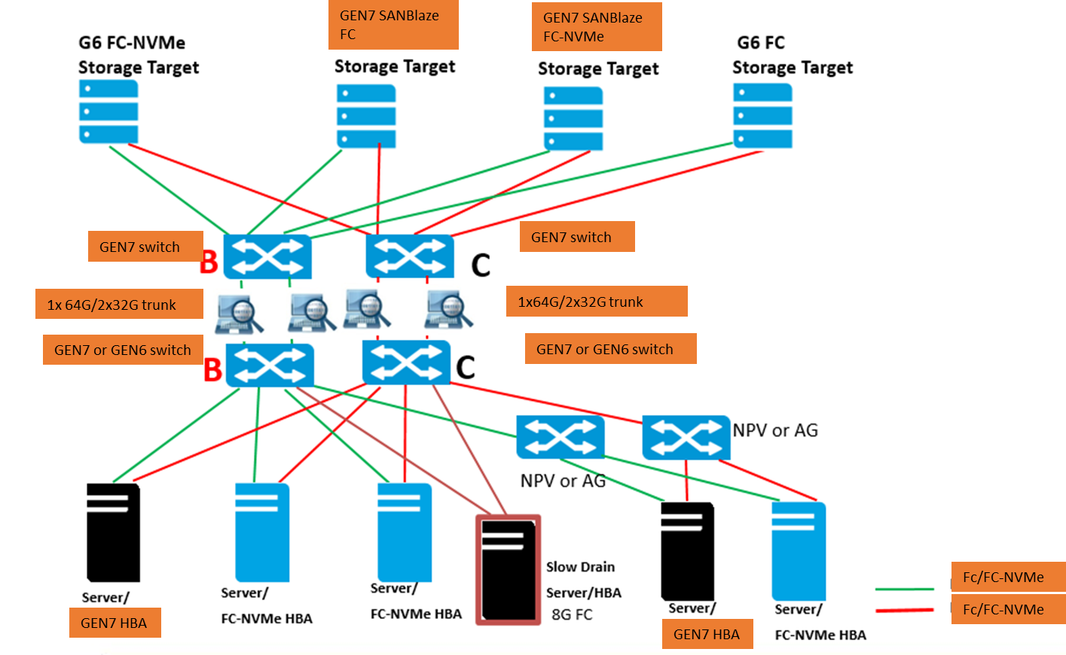
PlugFest topology- 1GbE OOB MGMT network via IOL patch cables
RJ45 serial switch or USB to RJ45 adapters
Demonstrate trunk advantage vs ISLs (DSL)
Verify FDMI data

Slide 13
UNH-IOL Interact use for FC-NVMe conformance
Ubuntu 20.04 & 22.04 are stable and will be capable of running Interact fully, so if you plan to use these operating systems you should be all set!
22.04 Kernel 5.15 downgrade to 5.10 (less coverage if cannot downgrade)
For RHEL 9.1 & 9.2 we ran into more issues than occurred on 9.0.
While we can get the tool installed the kernel is limiting the number of tests that can be run substantially on initial testing.
The main issue we are running into is the newer kernel has config_struct_devmem enabled.
This causes two NVMe cli commands to fail (nvme list, & show-regs) these commands are the only commands that map PCIe bars into user space.
This issue is occurring on PCIe and it might not occur on a fabrics setup.
Interact relies on the get-property command instead.
Further investigation – kernel 5.14 has issues – not full coverage

Slide 14
Adtran optical transport – Consensus is yes
I'm envisioning us setting up our transport gear as a secondary optical link between the B Switches.
Traffic can be run via the direct link for a portion of the time, and then we can also run traffic via our transport gear as well.
This would allow us to demonstrate our ability to run FC traffic over distance, with trunking, at multiple data rates (as desired).
Note: HPE to provide 20-25km SMF LC pods (2 or 4) and patch cables

Slide 15
UNH-IOL discussion
IOL can provide Medusa licenses – ok on Ubuntu, RH, WS
IO test tools – Medusa; FIO; IOMETER
INTERACT logs are proprietary to consortium members
No detailed logs – pass fail indicator – logs can be obtained by joining or paying per test
Bring extra HBAs for IOL servers (if driver is in box)
SPDK – target to get more nvme ports. Broadcom can bring a server.
SANBlaze can be target or initiator FC and/or FC-NVMe
HPE bring a 64GFC SANBlaze – for additional target ports

Slide 16
HPE ProLiant DL360 Gen11 servers P51931-B21
Server Name | iLO IP Address | Server Management Address | Operating System | Adapter | Adapter Port 1 (on switch) | Adapter Port 2 (on switch)
Rack-E18-UNH1 | 172.17.5.88 | 172.17.5.91 UN: barry PW: DASsanlab1 | Ubuntu 22.04.3 Nvme cli 2.4 | SN1700E 64GFC HBA | Port 41 (Port 0 on adapter) 10:00:b4:7a:f1:6d:14:ed | Port 45 (Port 1 on adapter) 10:00:b4:7a:f1:6d:14:ee
Rack-E18-UNH2 | 172.17.5.89 | 172.17.5.92 UN: root PW: DASsanlab1 | RHEL 9.2 Nvme cli 2.2.1 | SN1700Q 64GFC HBA | Port 42 51:40:2e:c0:17:2b:76:bc | Port 46 51:40:2e:c0:17:2b:76:be
Rack-E18-UNH3 | 172.17.5.90 | 172.17.5.93 UN: Snesanbox\administrator PW: sanlab1 | WS2022 | SN1700E 64GFC HBA | Port 43 (Port 0 on adapter) 10:00:B4:7A:F1:6E:64:72 | Port 47 (Port 1 on adapter) 10:00:B4:7A:F1:6E:64:73
HPE SANBlaze | FC0 – FC-NVMe 20:00:00:11:0d:62:75:00 | FC0 – FC-NVMe 20:01:00:11:0d:62:76:00 | FC2 20:02:00:11:0d:66:0c:00 | FC3 20:03:00:11:0d:66:0d:00 | FC4 20:04:00:11:0d:62:2a:00 | FC5 20:05:00:11:0d:62:2b:00
Note: Trunking needs to be enabled on both switches, it is by default, and the ISL of a single switch needs to all be on the port group.
cat /etc/nvme/hostnqn r82-s09 e19dl3851
modprobe -r qla2xxx
modprobe qla2xxx
nqn.2014-08.org.nvmexpress:uuid:39313550-3133-584d-5133-3239304a3139 nqn.2014-08.com.sanblaze:virtualun.virtualun.0.0 nqn.2014-08.com.sanblaze:virtualun.virtualun.1.0
# dmesg |grep traddr
qla2xxx [0000:12:00.1]-ffff:20: register_localport: host-traddr=nn-0x51402ec0172b76bf:pn-0x51402ec0172b76be on portID:12e00
register_localport: host-traddr=nn-0x51402ec0172b76bd:pn-0x51402ec0172b76bc
qla2xxx [0000:12:00.1]-2102:20: qla_nvme_register_remote: traddr=nn-0x200100110d627600:pn-0x200100110d627600 PortID:012400
qla2xxx [0000:12:00.1]-2102:20: qla_nvme_register_remote: traddr=nn-0x200000110d627500:pn-0x200000110d627500 PortID:012000
nvme discover --transport fc \--traddr nn-0x200100110d627600:pn-0x200100110d627600 \--host-traddr nn-0x51402ec0172b76bf:pn-0x51402ec0172b76be
nvme discover --transport fc \--traddr nn-0x200100110d627600:pn-0x200100110d627600 \--host-traddr nn-0x51402ec0172b76bf:pn-0x51402ec0172b76be
nvme connect --transport fc \--traddr nn-0x200100110d627600:pn-0x200100110d627600 \--host-traddr nn-0x51402ec0172b76bf:pn-0x51402ec0172b76be \-n nqn.2014.08.com.sanblaze:virtualun.virtualun.1.0
--traddr nn-0x200000110d627500:pn-0x200000110d627500 \-n nqn.2014-08.com.sanblaze:virtualun.virtualun.0.0

